Slide 1

Go Fun Go & Run
Dr. Rasha Stohy
Eng. Rana Mohamed

Slide 2
Introduction
Teenagers today frequently struggle to find a good hangout spot, which leads to canceled plans and unhappiness. In order to assist people in creating hangouts that suit their needs and budget, It takes into account various factors like money, and location.

Slide 3
What we offer ?
Ducks Row addressed the problem of planning a hangout with friends or alone, taking into account the user's budget and preferences. The method takes into account the following factors:
The amount of money the user has available
The places the user would like to visit
The type of activity you want to do

Slide 4




User privileges
We have three privileges in our website.
User
Business account
Data Entry
Admin
The normal user can see make a plan and add places to it.
Next to the normal user privilege he can also request to add his business.
This user can add places in a data entry page. And also have the normal user privilege.
He can accept and reject the requests. He can delete users and places. He has all the privileges on the website.

Slide 5
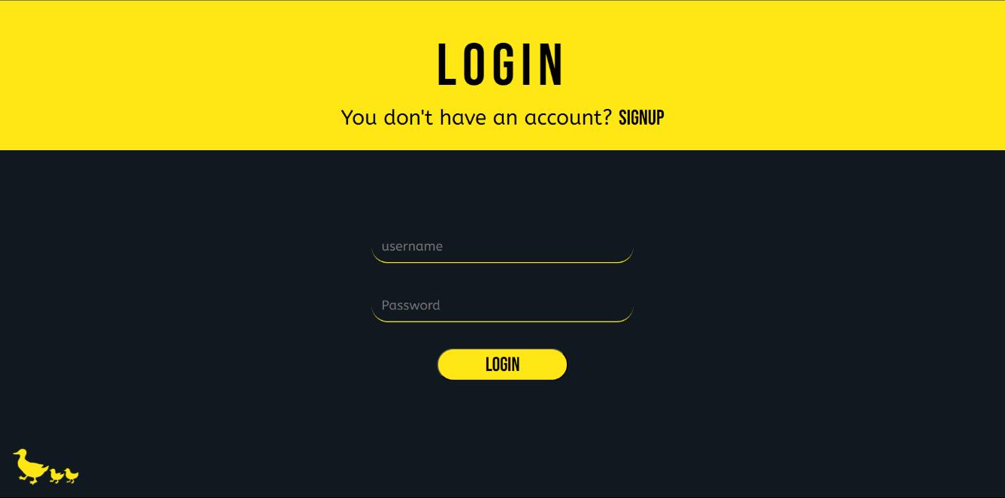
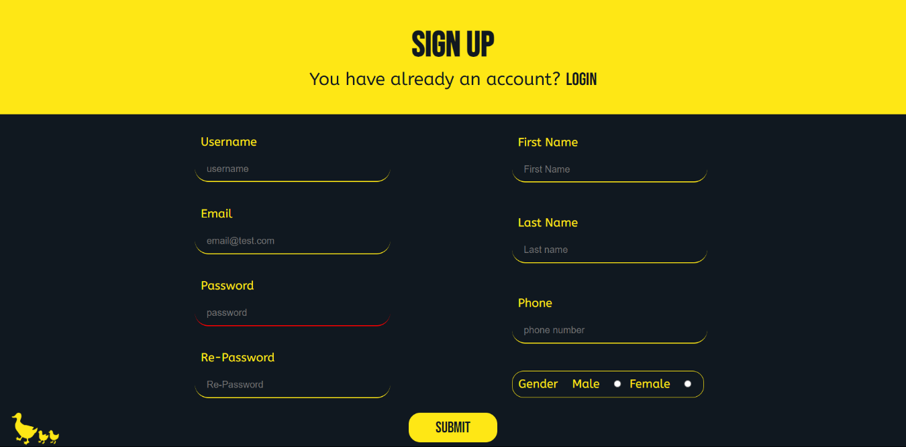
Registration and login form
We created a registration form with the user's basic information. such as his name, gender, or email. For user trust, we additionally created a secured form from the SQL injection and encrypted the password.

Slide 6
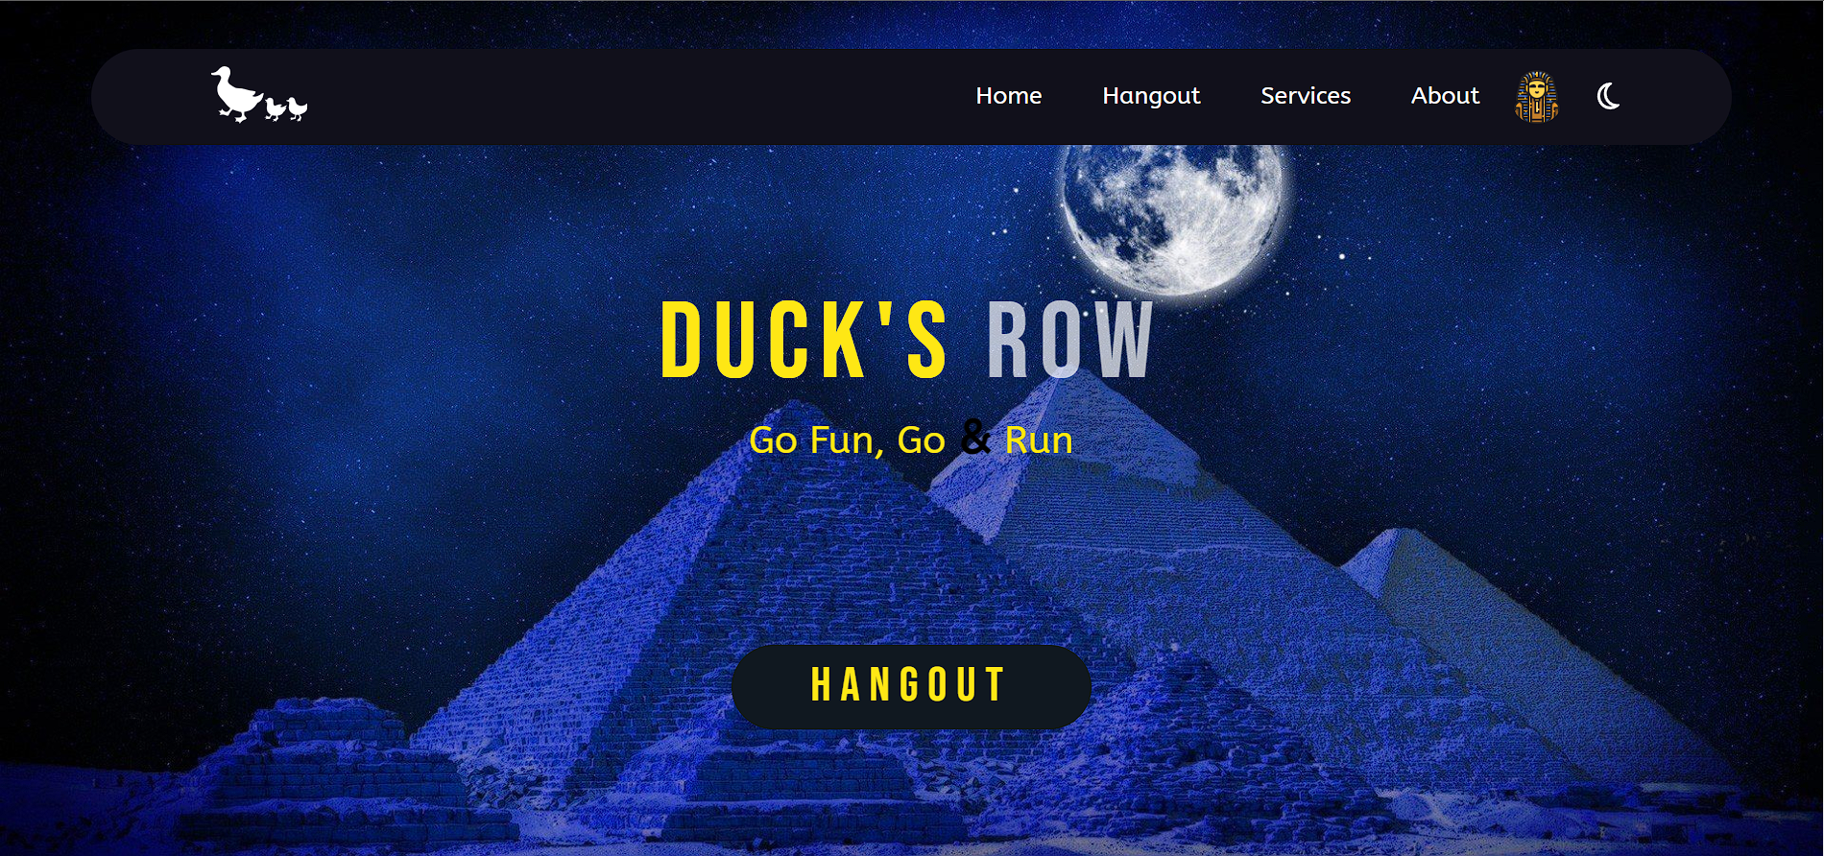
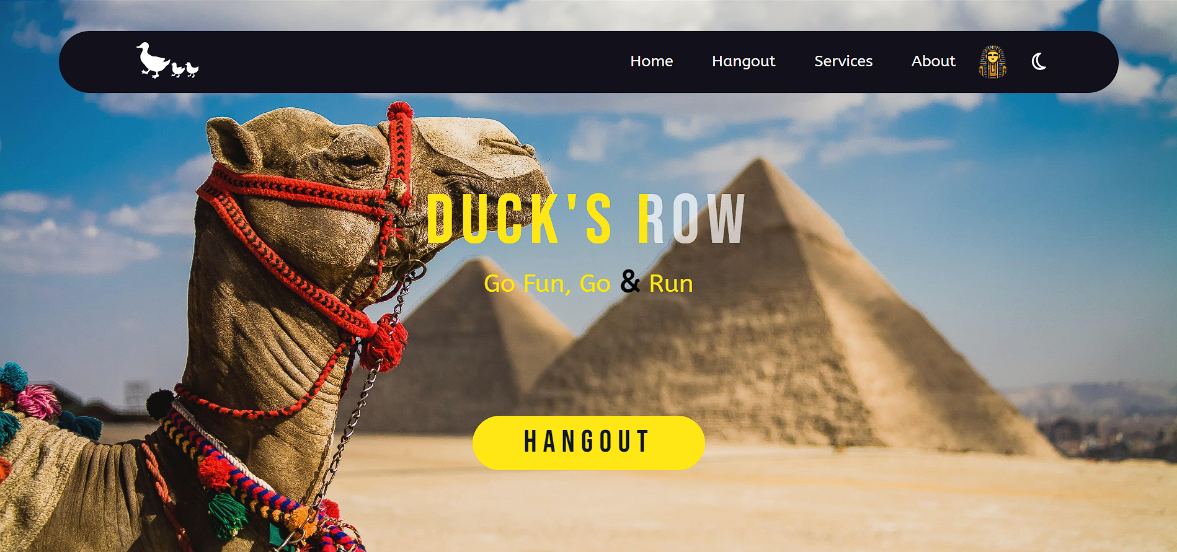
Home Page
The user interface is welcoming and simple to use, which is something we ensure.
The home page includes a lovely floating navbar with links to the website's primary pages. And a brief of the main website’s features as well as a way to get in touch with the development team

Slide 7
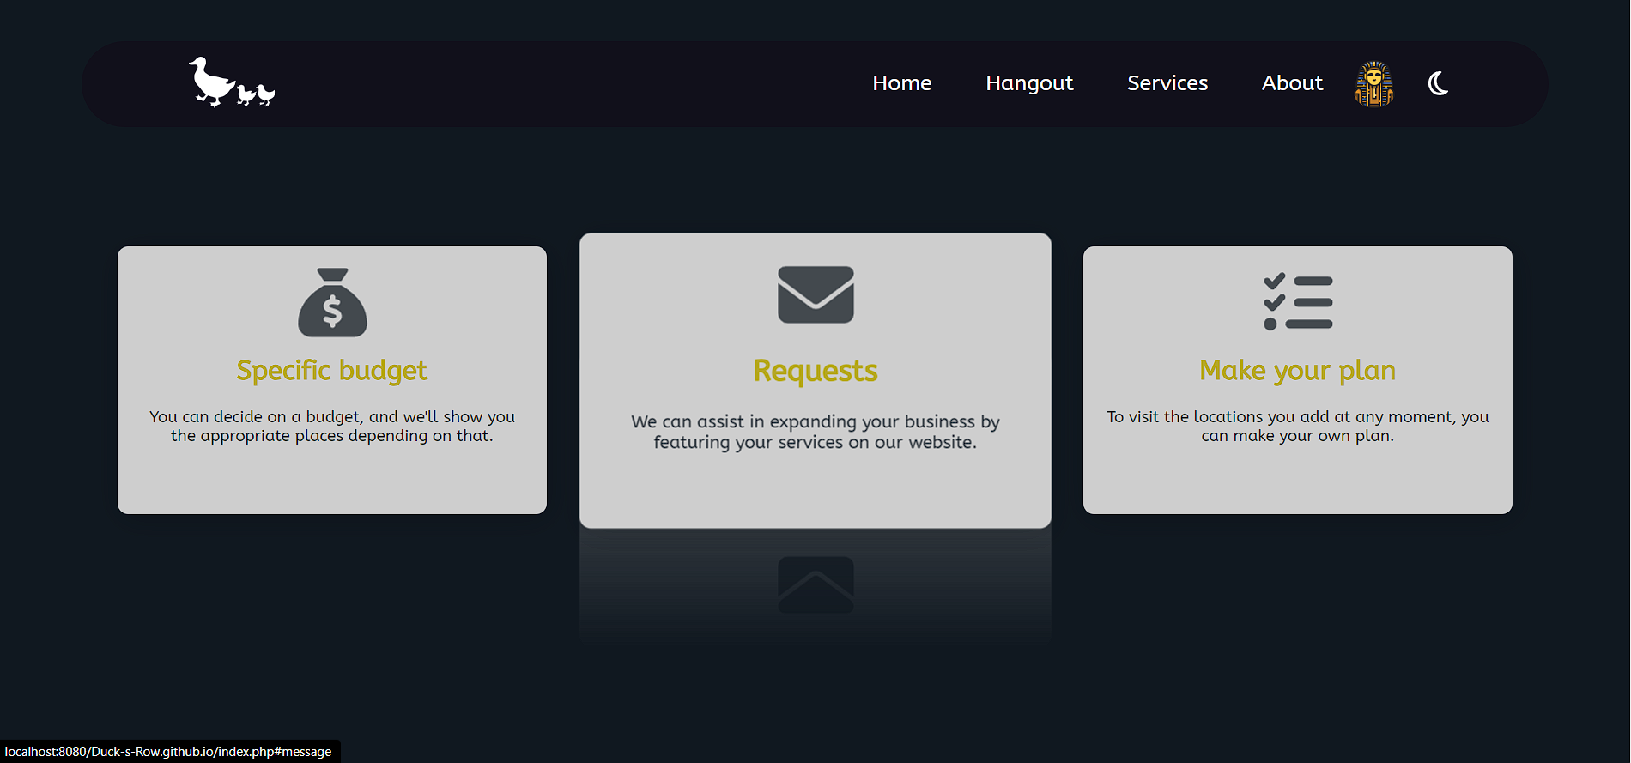
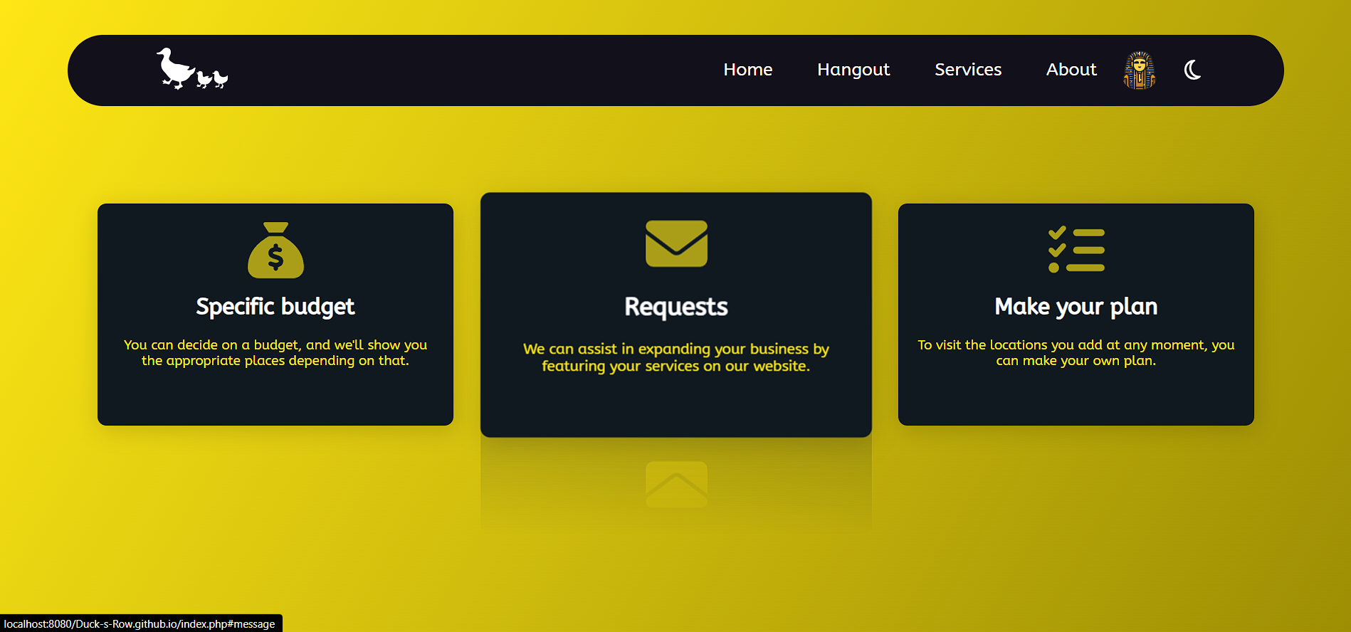
Our Services
We offer a range of services to help users navigate our site with ease and access the various resources available. These services include budget definition, itinerary planning, and recommendations for diverse and exciting destinations to visit.

Slide 8
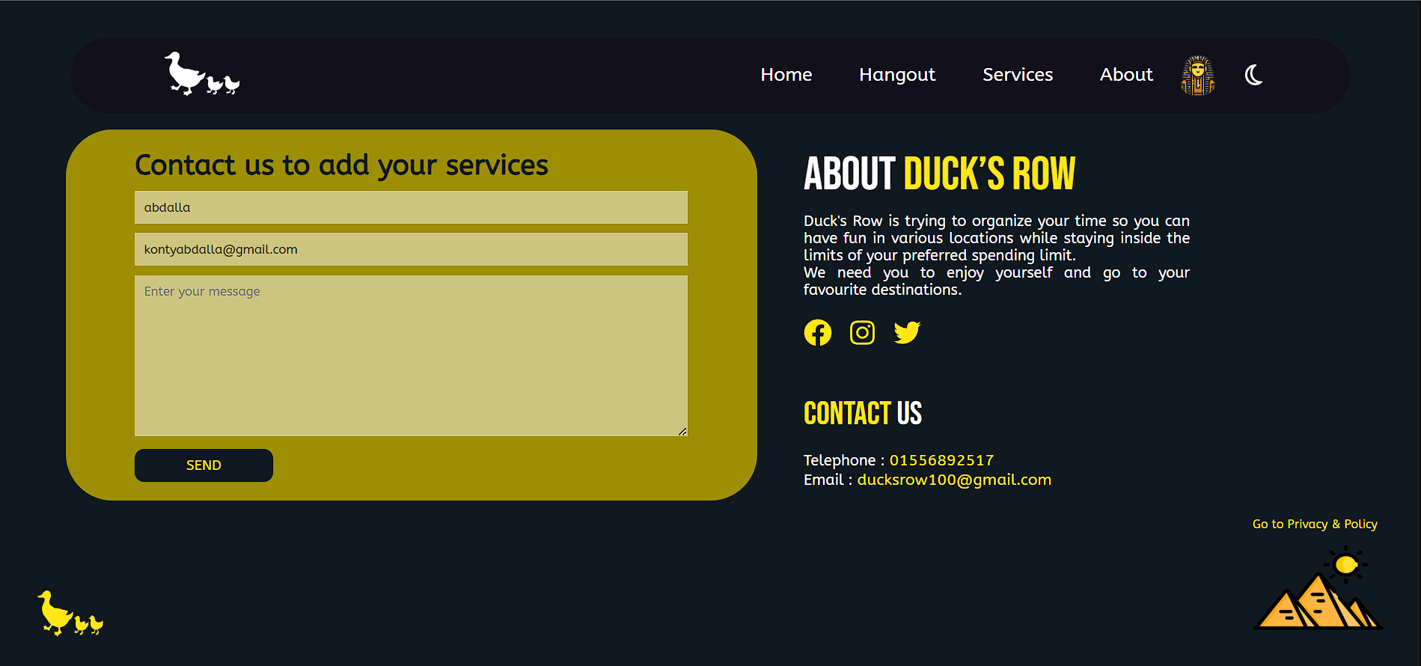
About and Contact us
We made an About and contact us , To get acquainted with the services provided by our site in a brief way and to easily communicate with us by phone, e-mail or social networking sites. The contact form is used to send us a request to put your buisniss in our website by sending us an email so the admins change the privilage of the user.

Slide 9
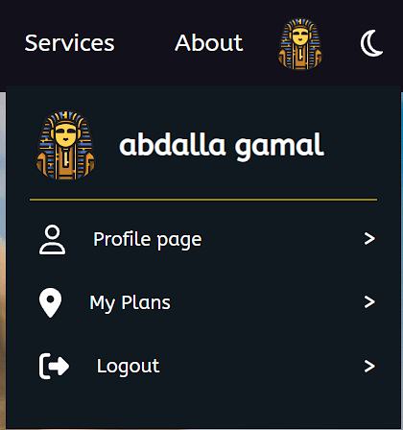
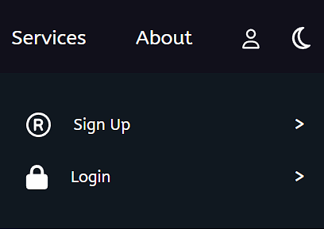




Navigation bar
Sub navigation bar
Admin
Data Entry
User
Business account

Slide 10
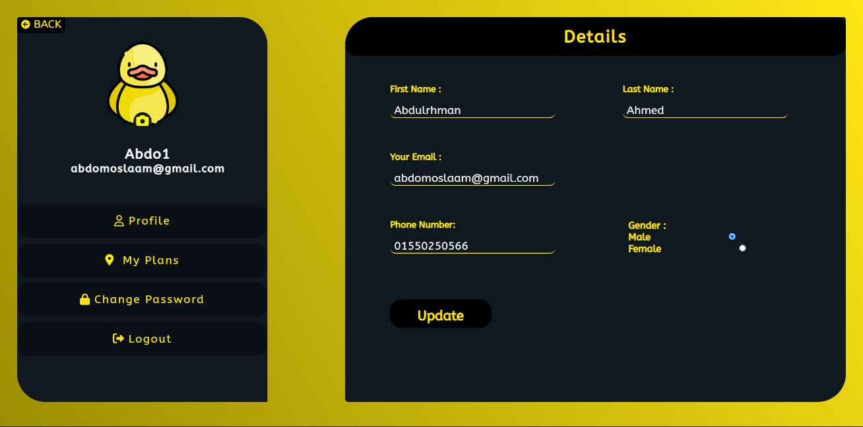
Profile Page
In the profile page we have two sections on the left we have the user avatar and he can upload any photo he likes, and the main buttons in the profile page. According to the left button activated the content on the right side is changed. In the profile we can Change the main data that you entered in the sign up.

Slide 11
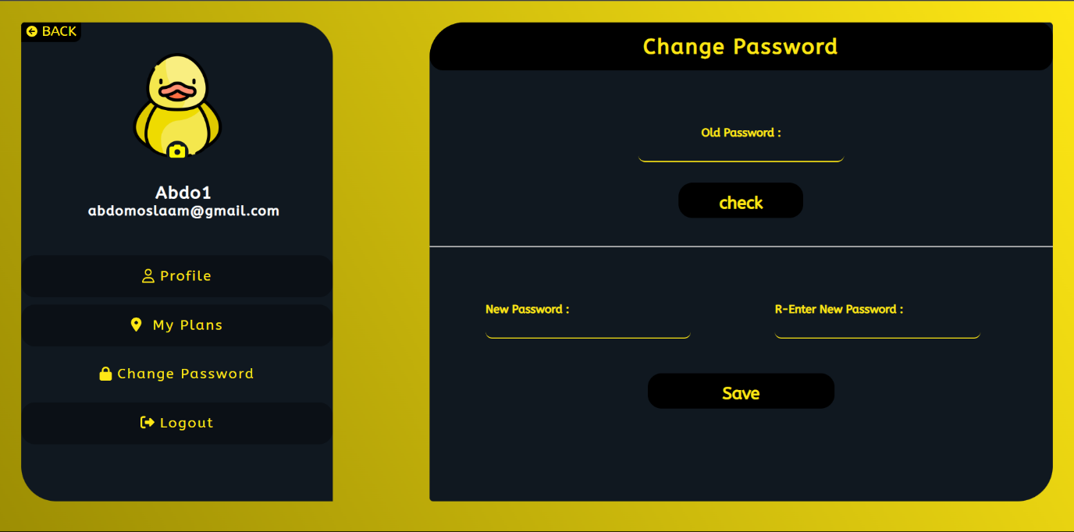
Change Password and photo in Profile
Here the user can change his password by writing the old password , check it and then entering the new password.
He can also add a profile picture by clicking on the camera icon and choosing the picture he wants

Slide 12
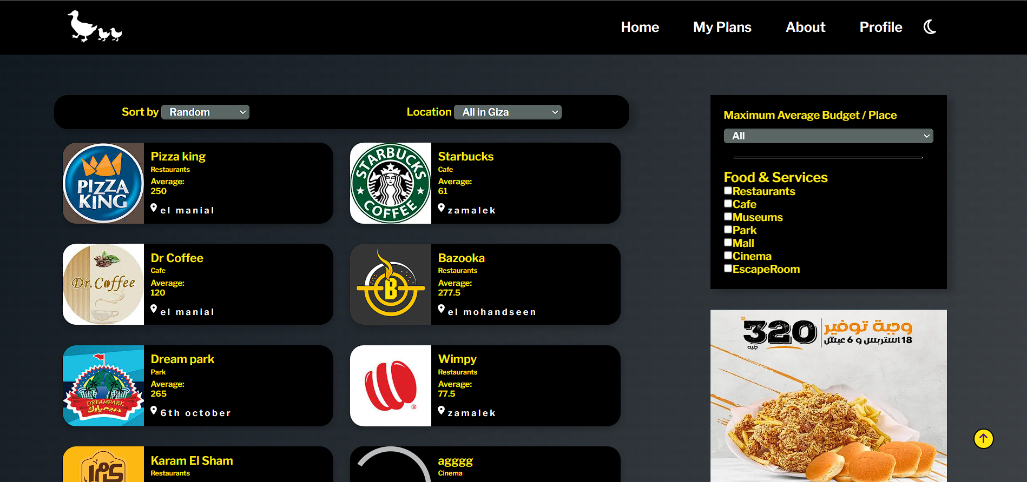
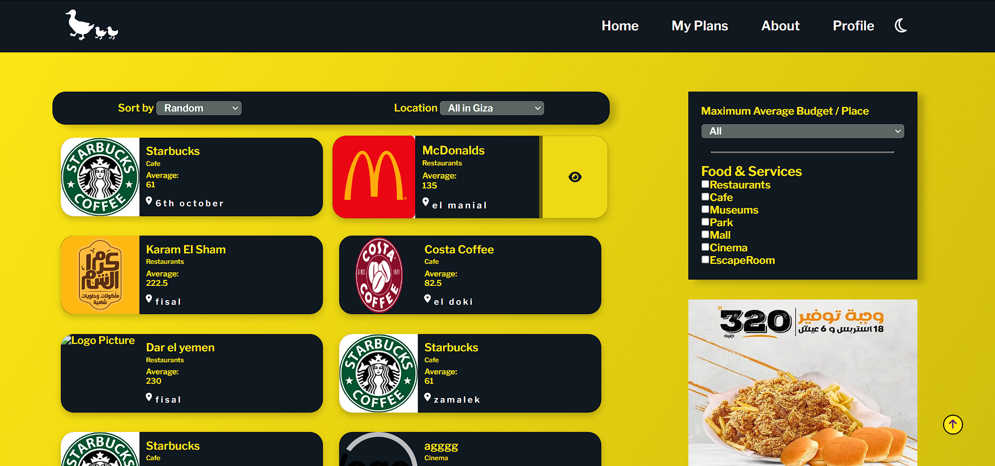
Hangout Page
The Entertainment time Page is the page where the user chooses his Cost for every place, Location, and activities. From the user choices the Cards of the places are changing. The More button is Showing more details about the place.

Slide 13
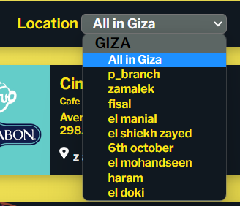
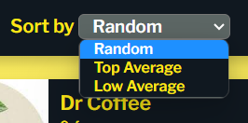
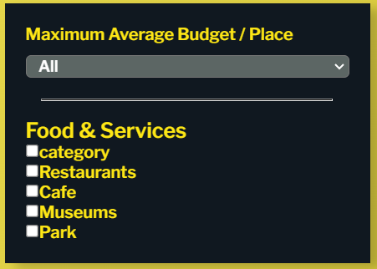
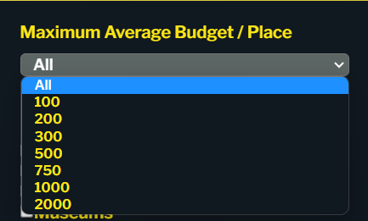
Budget and Filters in Hangout
Here are some filters that help the user to get the most suitable place according to his choices, such as specifying the area in which he wants to go out, or according to the least and most average
Here are filters that depend on the user's choices for the appropriate category or budget

Slide 14
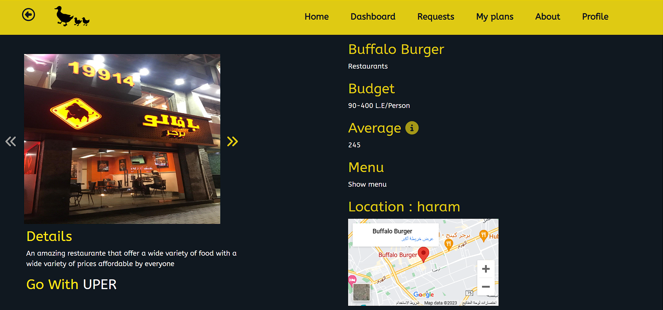
Information page
This page contains more details about the place, its address, budget and average. It also contains an add to my plan button, to add the place to his plan.

Slide 15
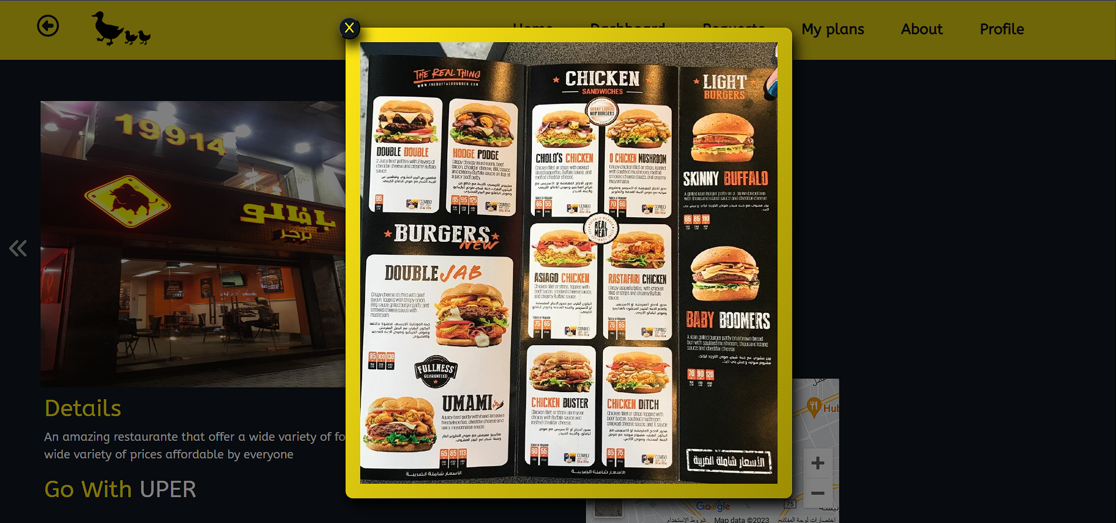
Information page
If the chosen place have a menu, we made a place for it to inform the user all the details you need before you go to this place.

Slide 16
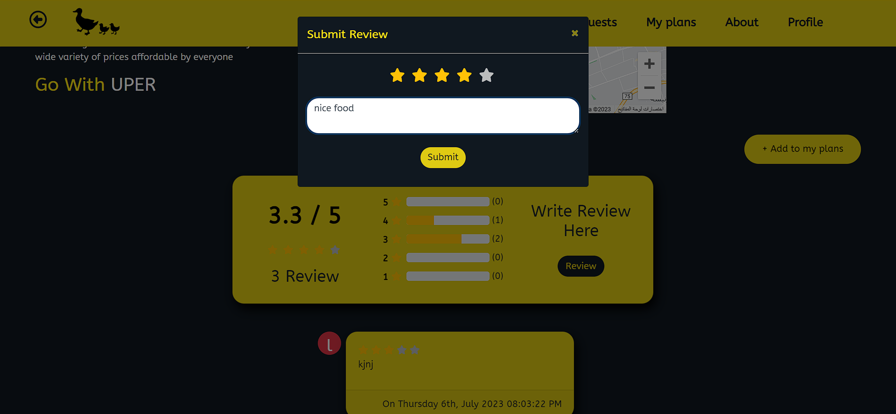
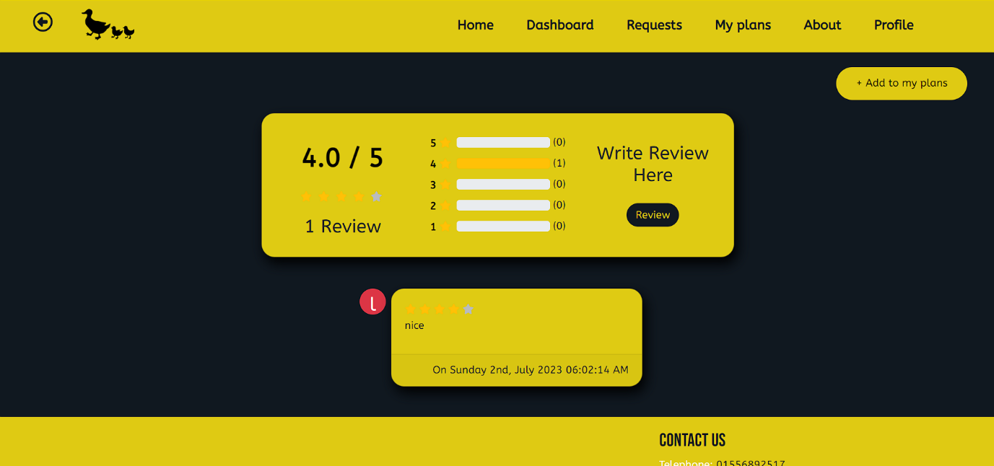
Information page
The rating is a very important this in any website. So, we made a rating system to give the users the ability to say there opinion about a specific place

Slide 17
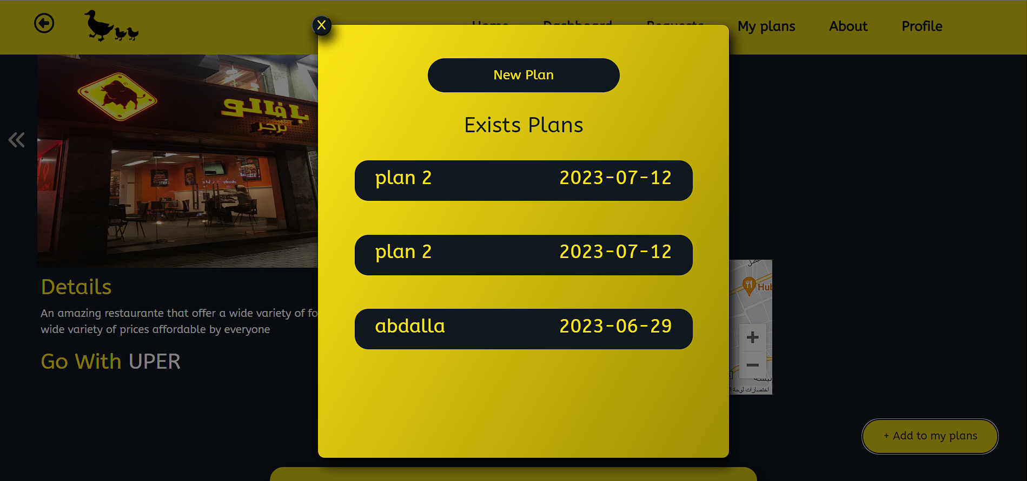
Add to my plan
Sure, you need to make a multiple plans with different names of dates. Now you can choose the place will be in which plan of yours.

Slide 18
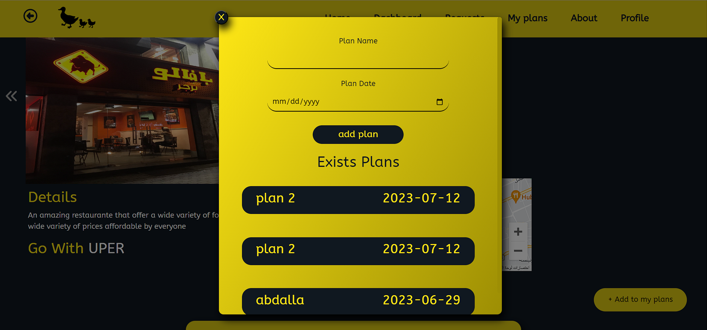
New plan
If you need to make a new plan with different name and date. Then by clicking on “New Plan” a form will appear to create a new plan.

Slide 19
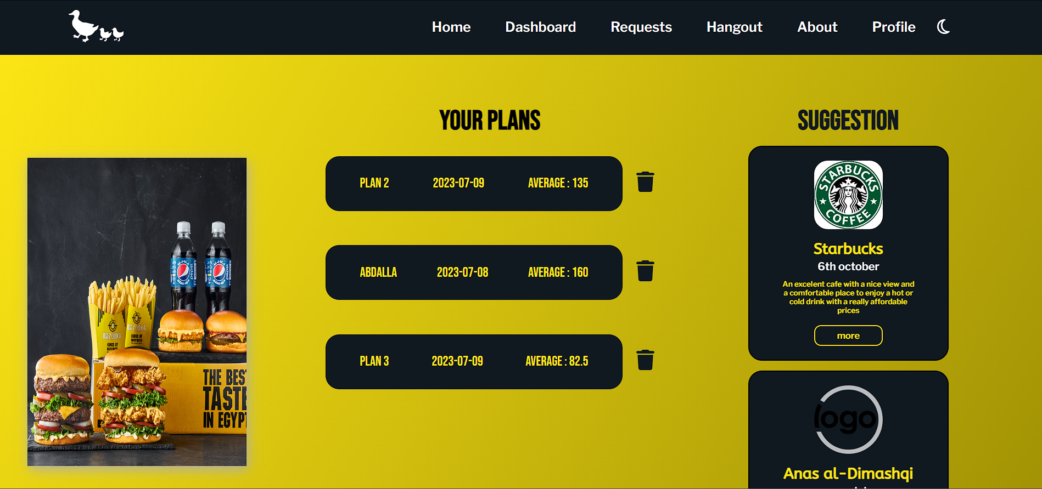
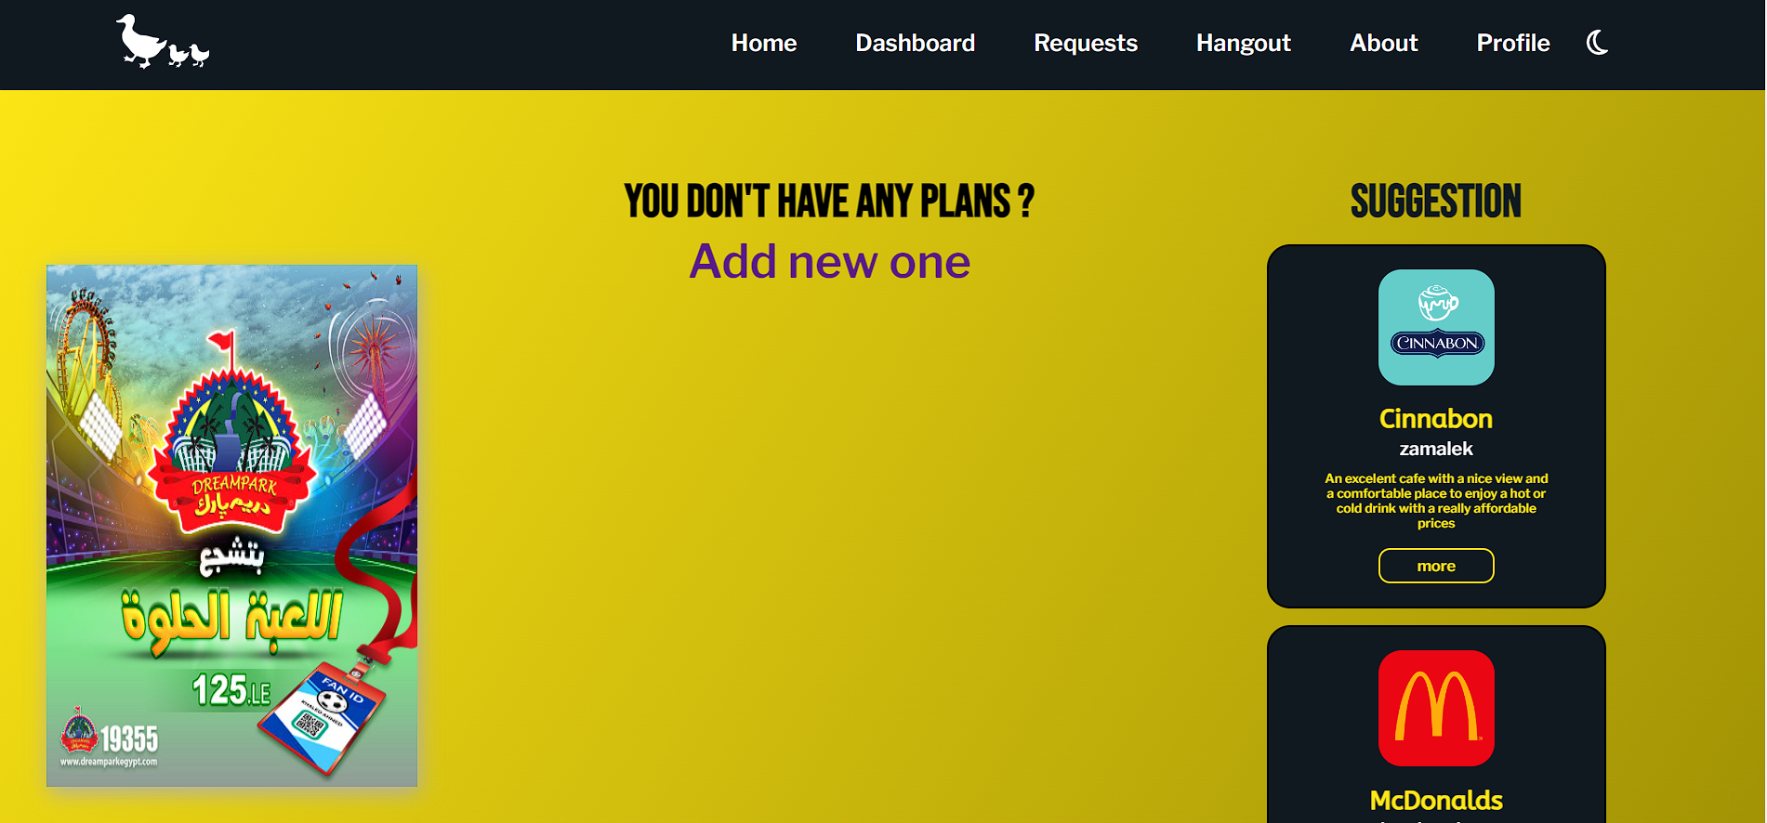
My Plans page
This page have all the plans that you created. And by clicking no it you can see the places that you have chosen in this plan.

Slide 20
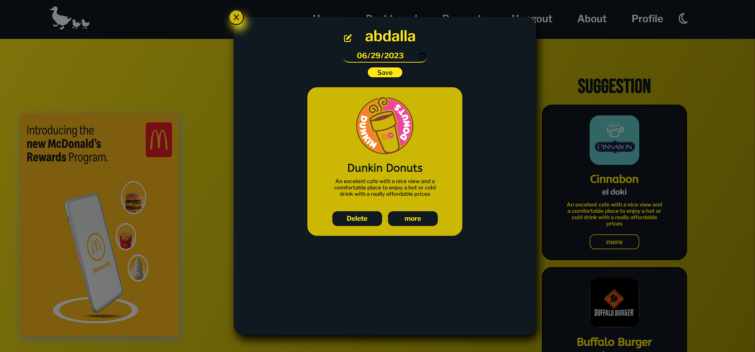
My Plans details
After clicking no one of your plans you can see the places that you have chosen in this plan. You can edit the place name, or date. You can also delete the place from the plan or see the details of it again.

Slide 21
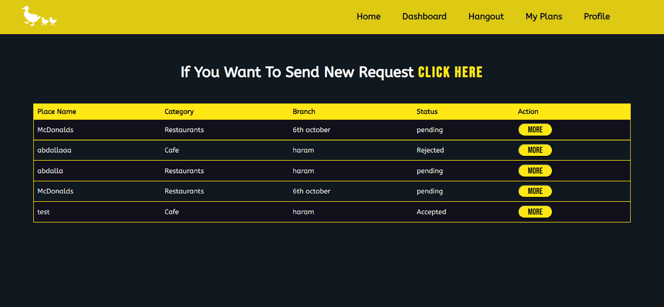
Request
In the request page of a company he can see all his requests, he can edit on it, and he can see the state of the request. if he want to make a new request he click “CLICK HERE” to go to a form to fill the necessary information.

Slide 22
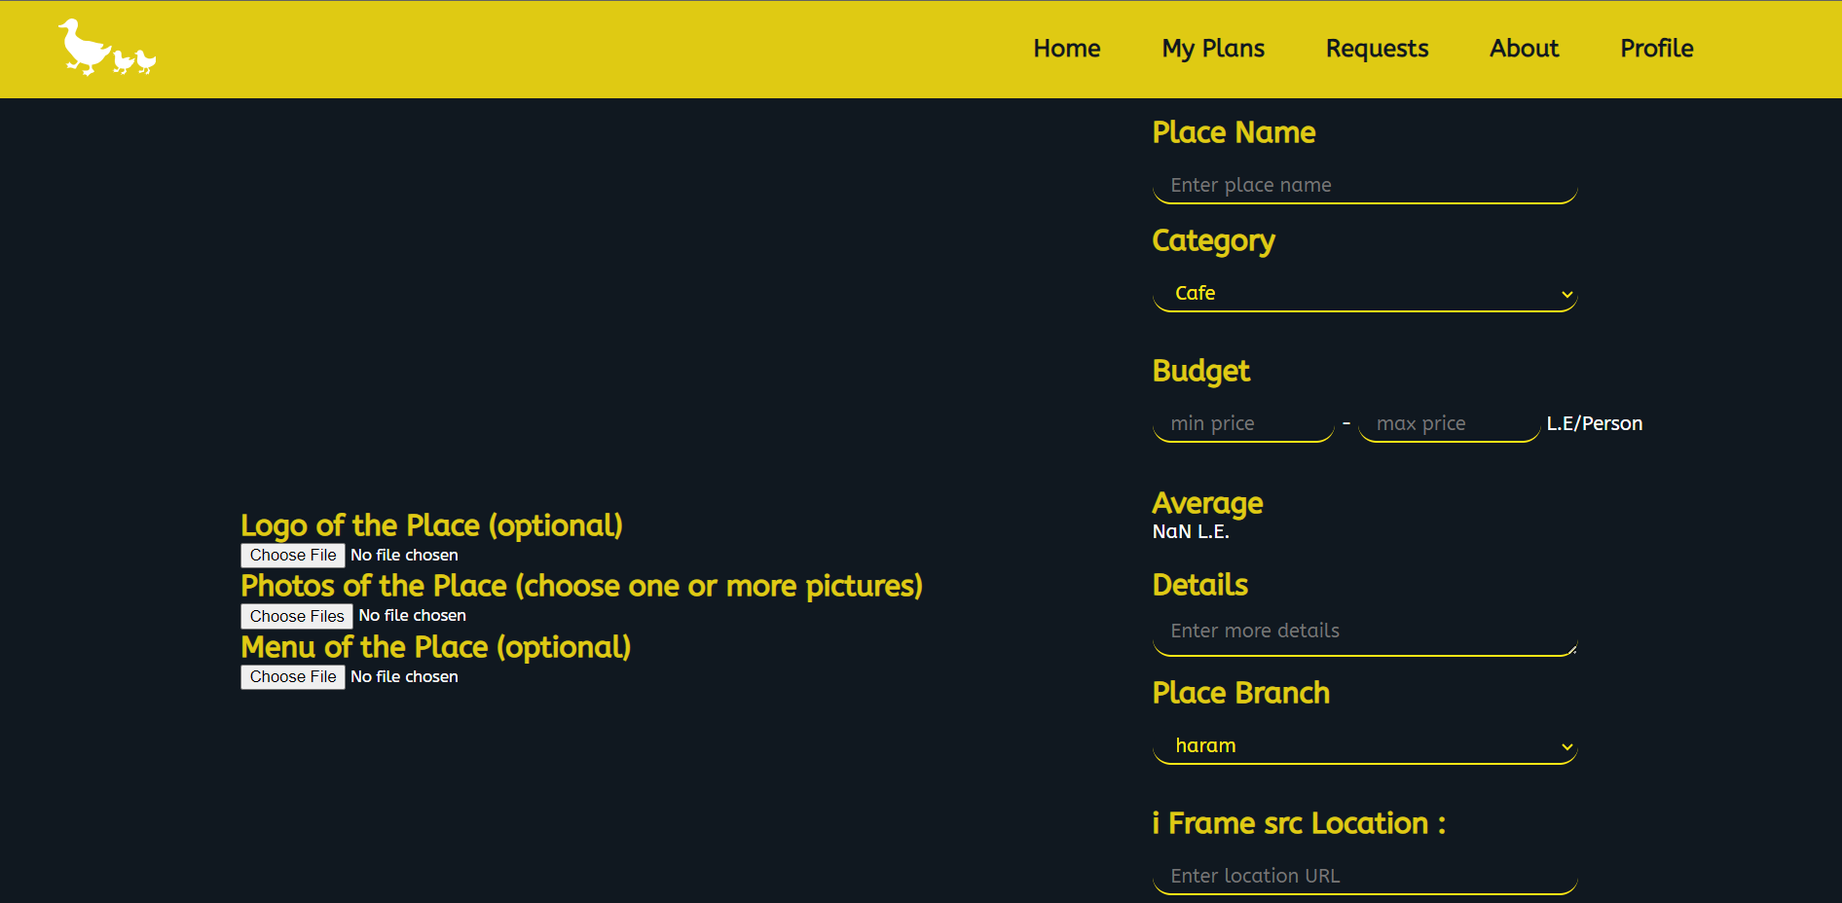
Request Form
In the request Form the user can add the photos of his place, the Name, the category, and other important information. After that he send a request and wait for the admins to accept the request of the user.

Slide 23
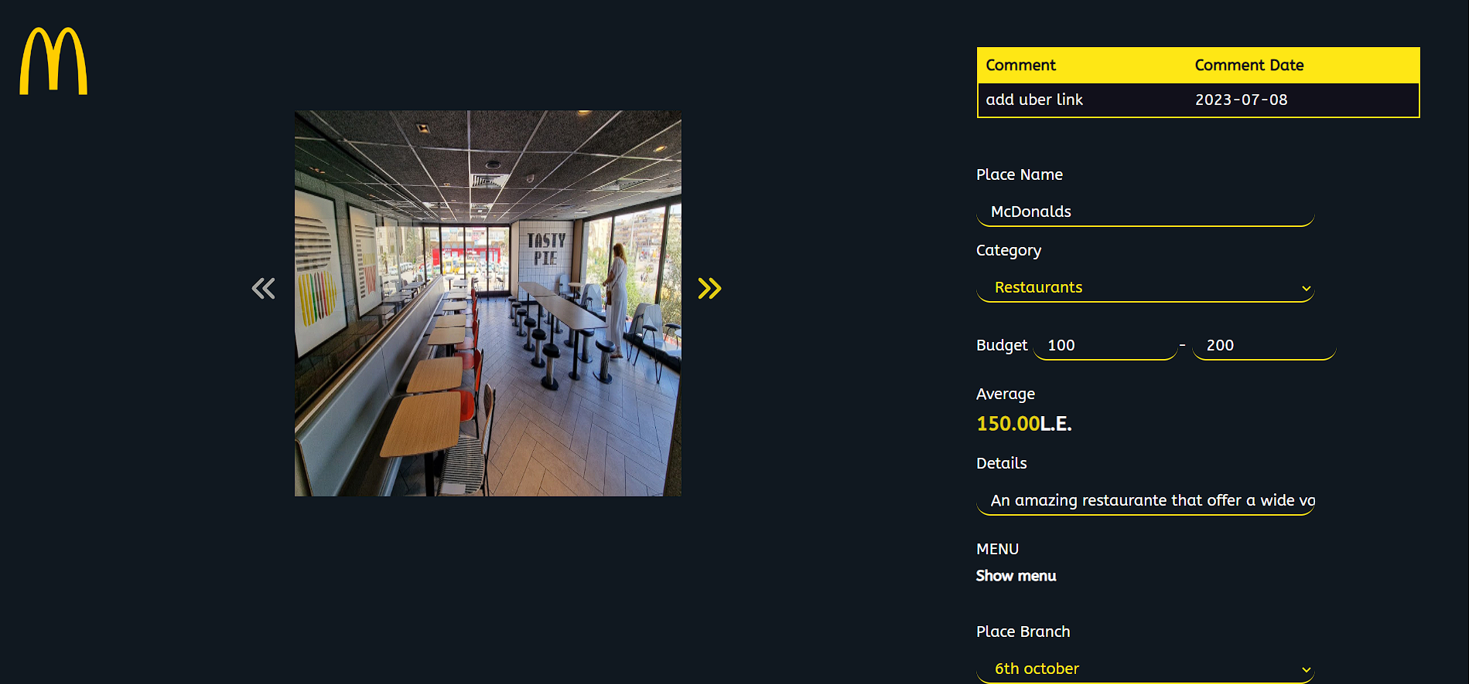
Request Details
In the request details the user can modify, update or add more details on his place if the request rejected by the admin. In case of accepted the user can not modify or update on his request.

Slide 24
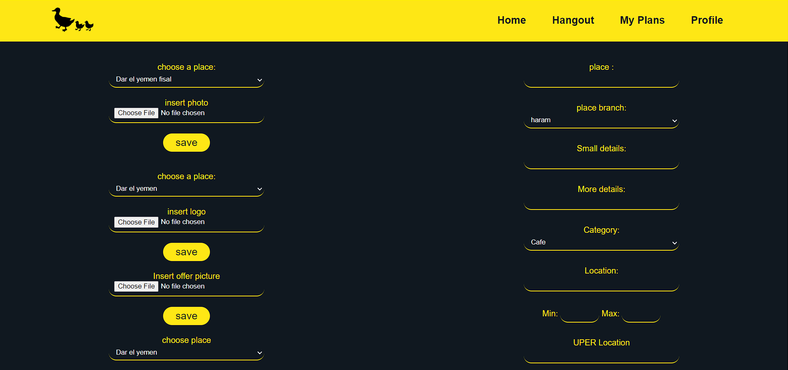
Data entry
This page allows the data entry user to enter data of the places without needing an approving from the admin. Also, without reaching to the dashboard.

Slide 25
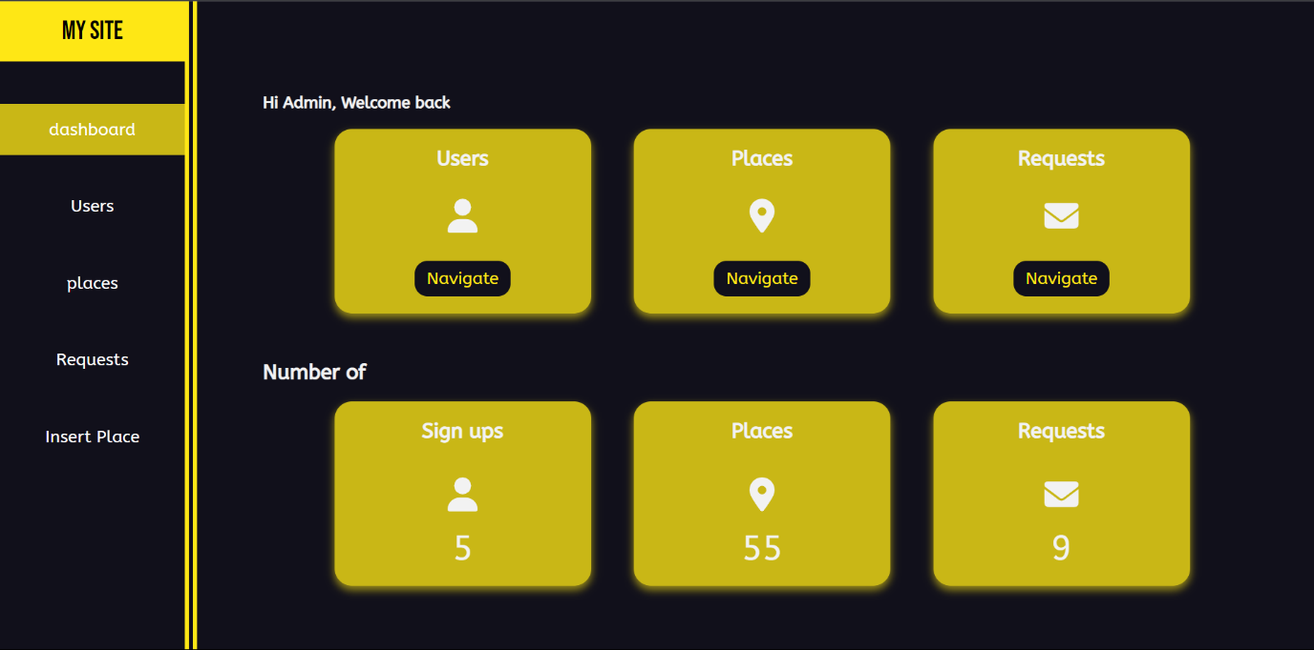
Dashboard
We created a dashboard for administrators so they could control the users and places on the website. Additionally, we created an insert page for a new addition.

Slide 26
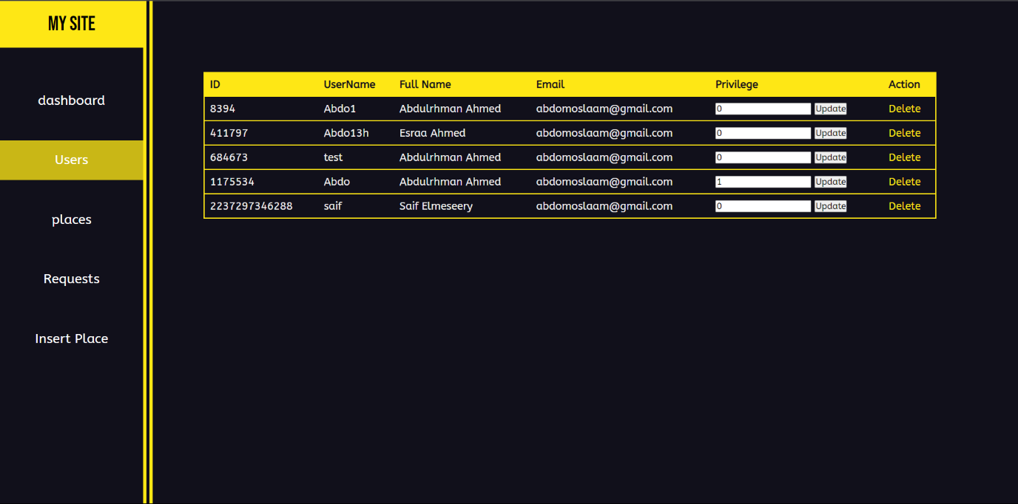
User control Page
We can see some basic information about the user in this table, we also can change the privilege of the users or delete the user from the website.

Slide 27
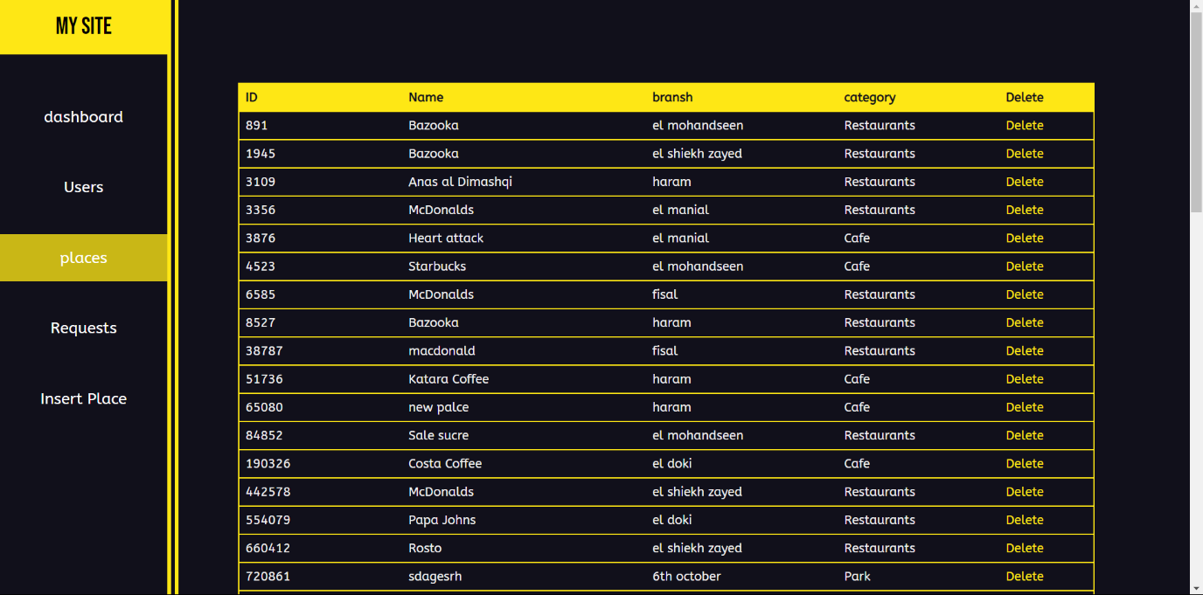
Places control Page
We can see some basic information about the Places in this table, we also can delete the place if needed.

Slide 28
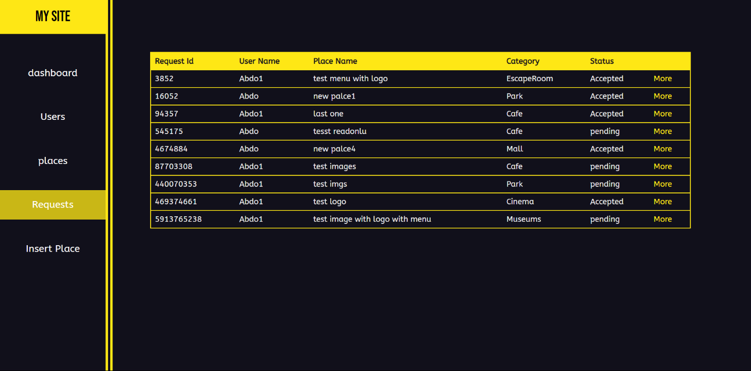
Requests control Page
We can see some basic information about the requests in this table. To accept or reject the request the admin click on more to see all the information about the place.

Slide 29
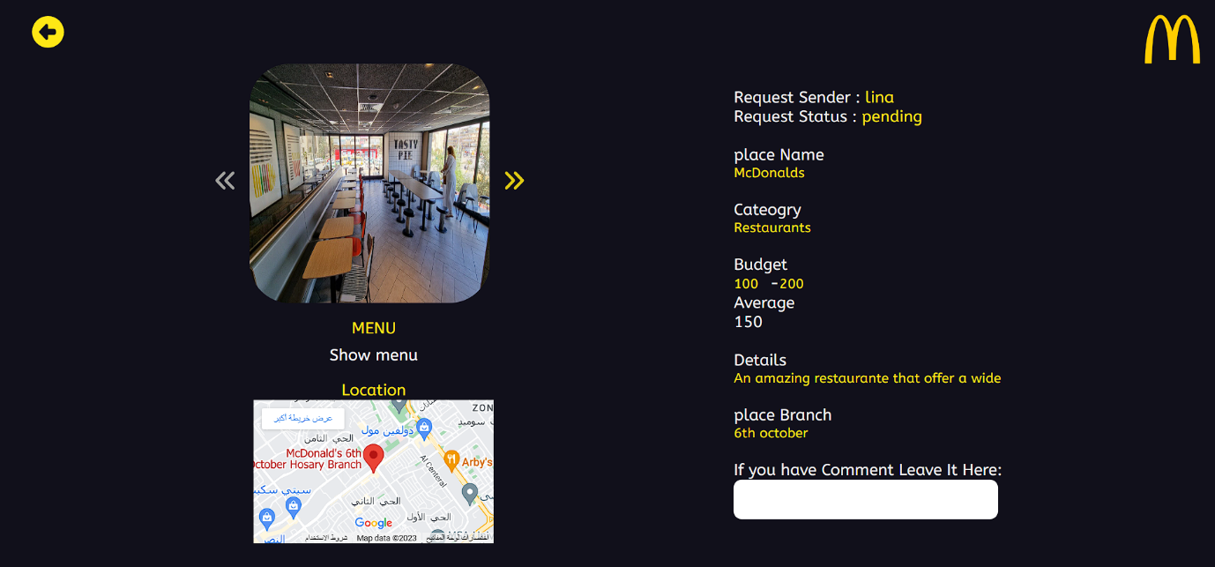
Requests control Page
From this page we chick all the details of the place before accept or reject and add some comments if needed. the user will see the comments and the state of his request and submit it again in the reject state.

Slide 30
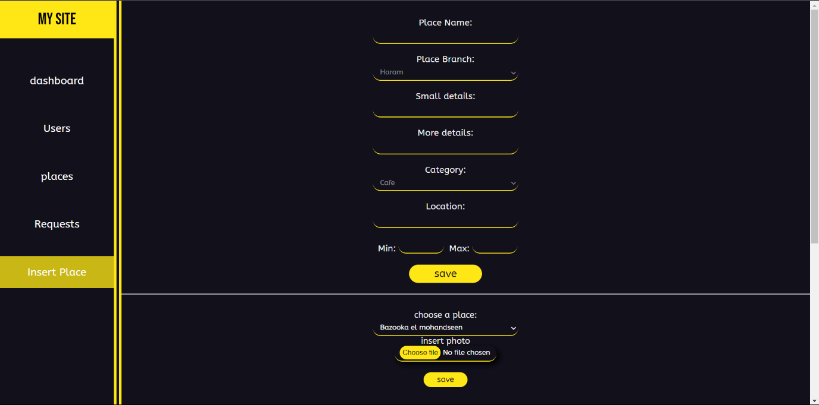
Insert control Page
We can insert the places in this form. And it will be accepted directly because of the admin privilege.

Slide 31
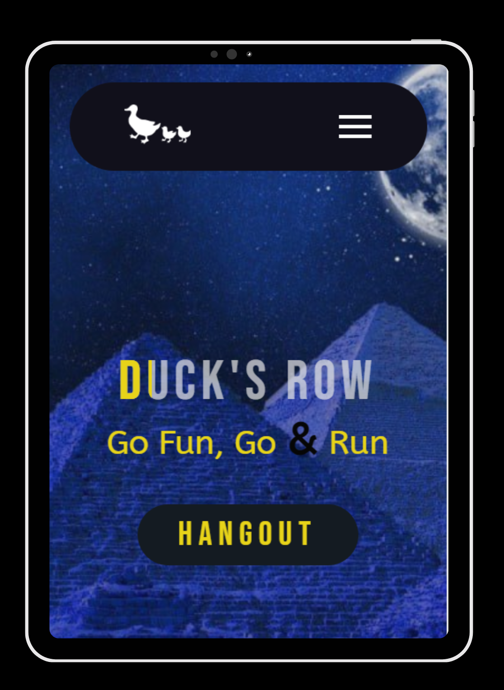
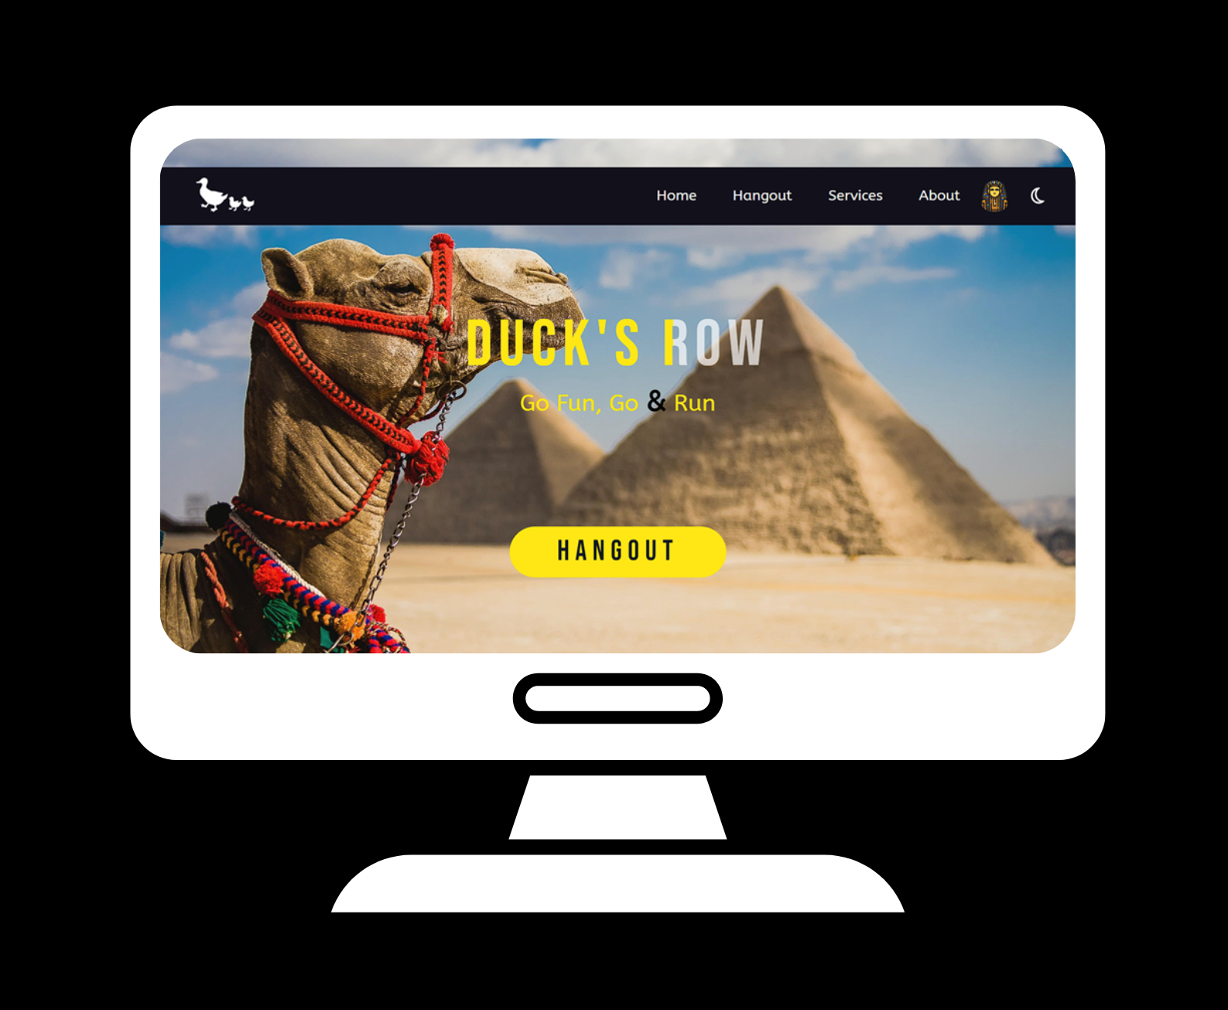
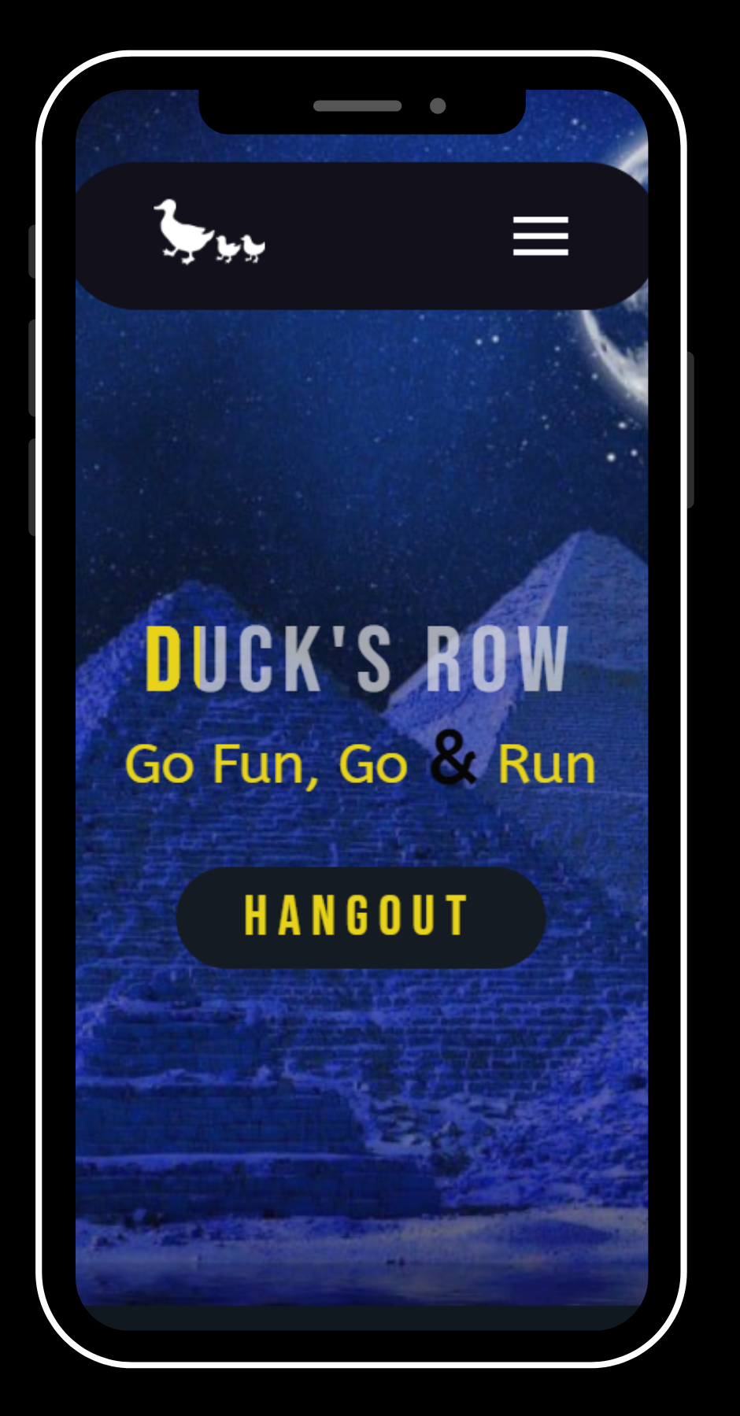
Responsive
You can use our website on several devices such as PCs , Tablet or Mobile

Slide 32
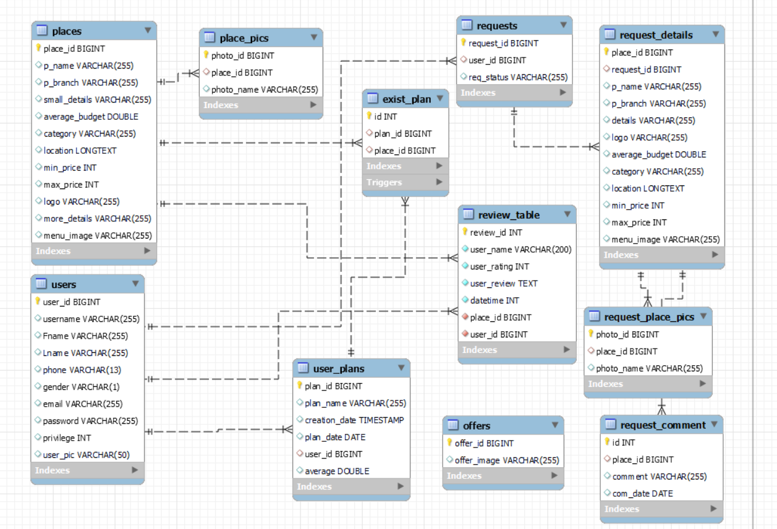
Database
Enhanced entity-relationship (EER) diagram

Slide 33
The tools that were used
HTML
CSS
JavaScript
PHP
Ajax
JQuery
JSON
MySQL workbench and PhpMyAdmin to create and work on the database
XAMPP as a localhost

Slide 34
Thank You
Team members :
Kareem Abdallah
Abdallah Gamal
Abdelrahman Ahmed
Abdelrahman Sherif
Omar Eid
Amr El-Sayed

